Slide 1

Spatial-temporal Programmable Metasurface for
Single Channel Radiation
Chengfan Li¹, Zhehao Yu¹, Yan Shen², Runqing cai¹, Xuyang Lu¹
¹ UM-SJTU Joint Institute, Shanghai Jiao Tong University
² School of Electronics and Information Technology,
Sun Yat-sen University

Slide 2
Outline
Introduction
5G Communication
Metasurface
Harmonic Suppression Theory
Unit Cell Design
Simulation Results
Conclusion

Slide 3
Outline
Introduction
5G Communication
Metasurface
Harmonic Suppression Theory
Unit Cell Design
Simulation Results
Conclusion

Slide 4
Introduction: New Era
More and more demand
Speed
Anytime, anywhere
Limited electromagnetic spectrum
Internet of things
Broad-scale
Efficiency
Saving

Slide 5
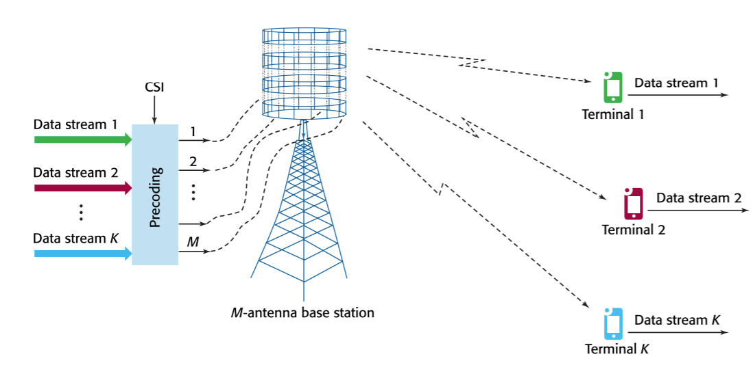
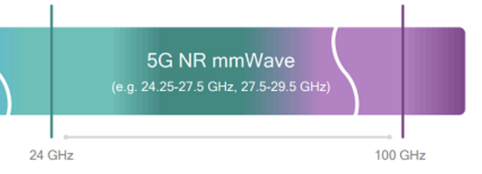
Traditional Solutions
Massive MIMO
Millimeter Wave Communication
High speed
Large band width
Spatial – division multiplexing
Phased array antenna
High cost and power consumption; Difficult to deploy
[8] T. L. Marzetta, et al.

Slide 6
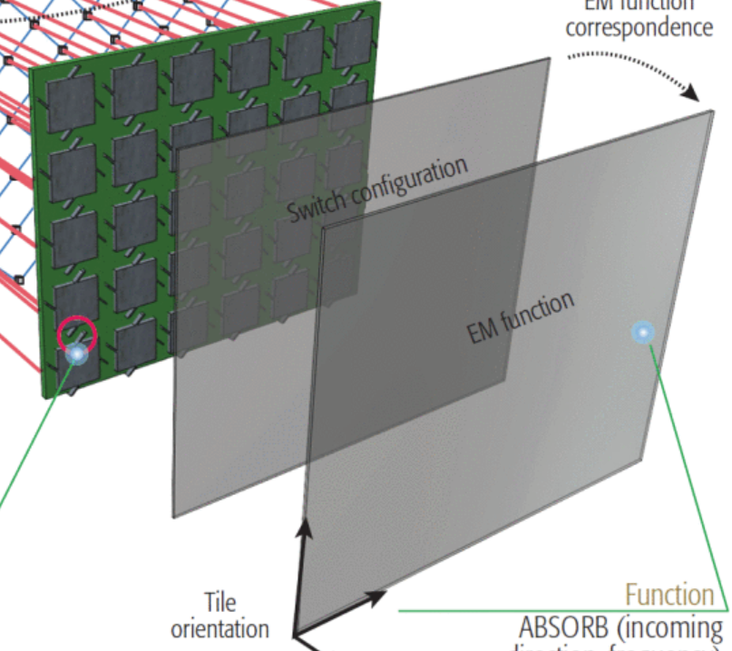
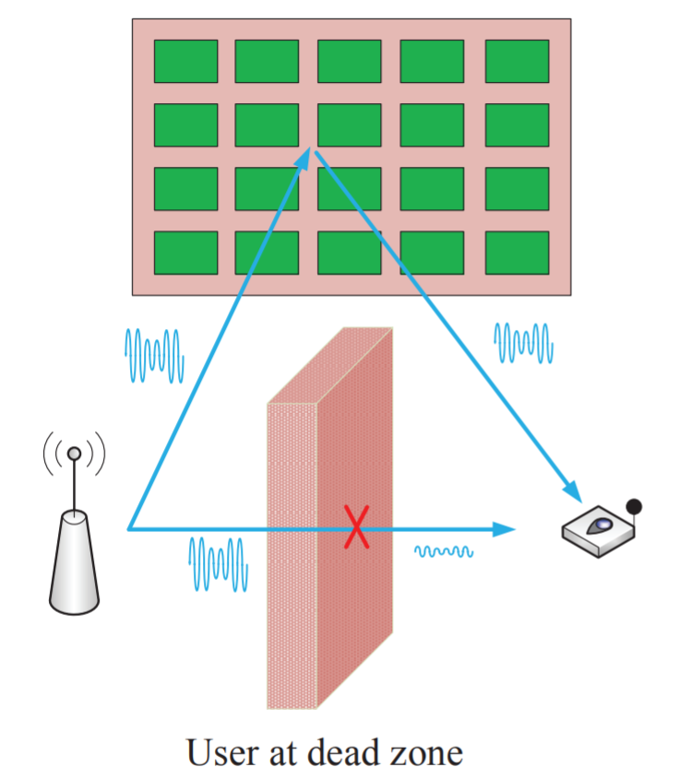
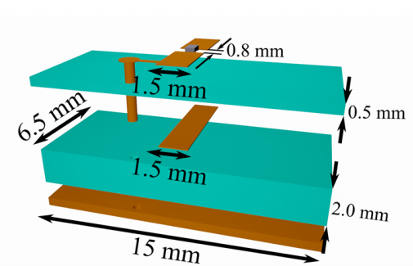
Intelligent Metasurface
Sample Structure
Dead Zone Relay
Programmable
Low cost; Low power consumption
High reliability
Intelligent programmable
High-precision
[9] Q. Wu and R. Zhang. [10] C. Liaskos, S. Nie, et al. [11] Popov, Vladislav, et al.

Slide 7
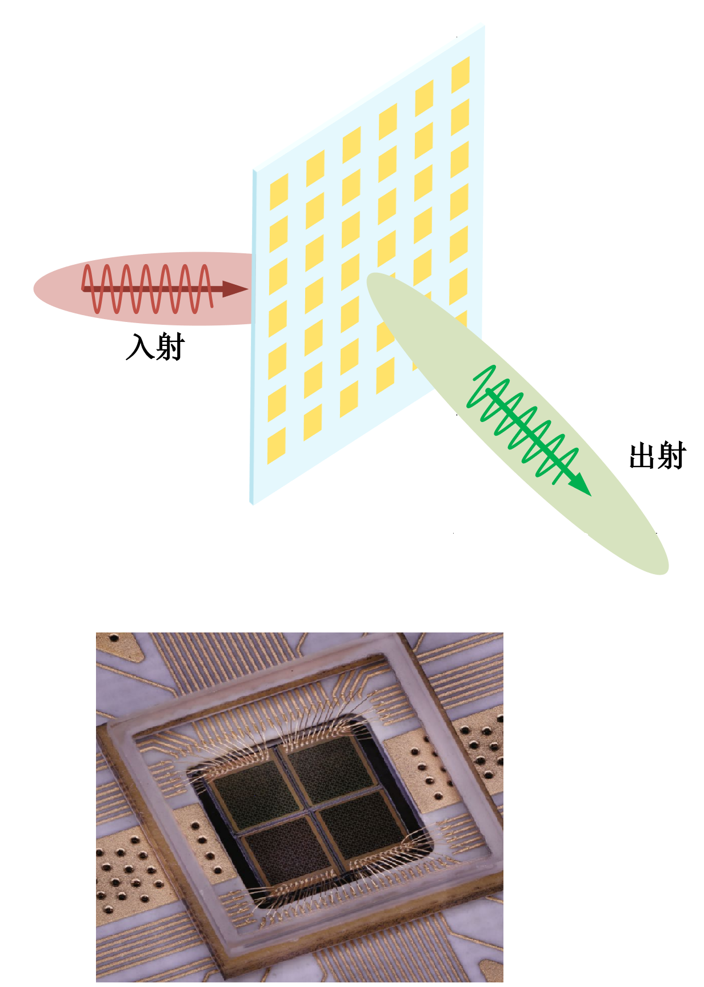
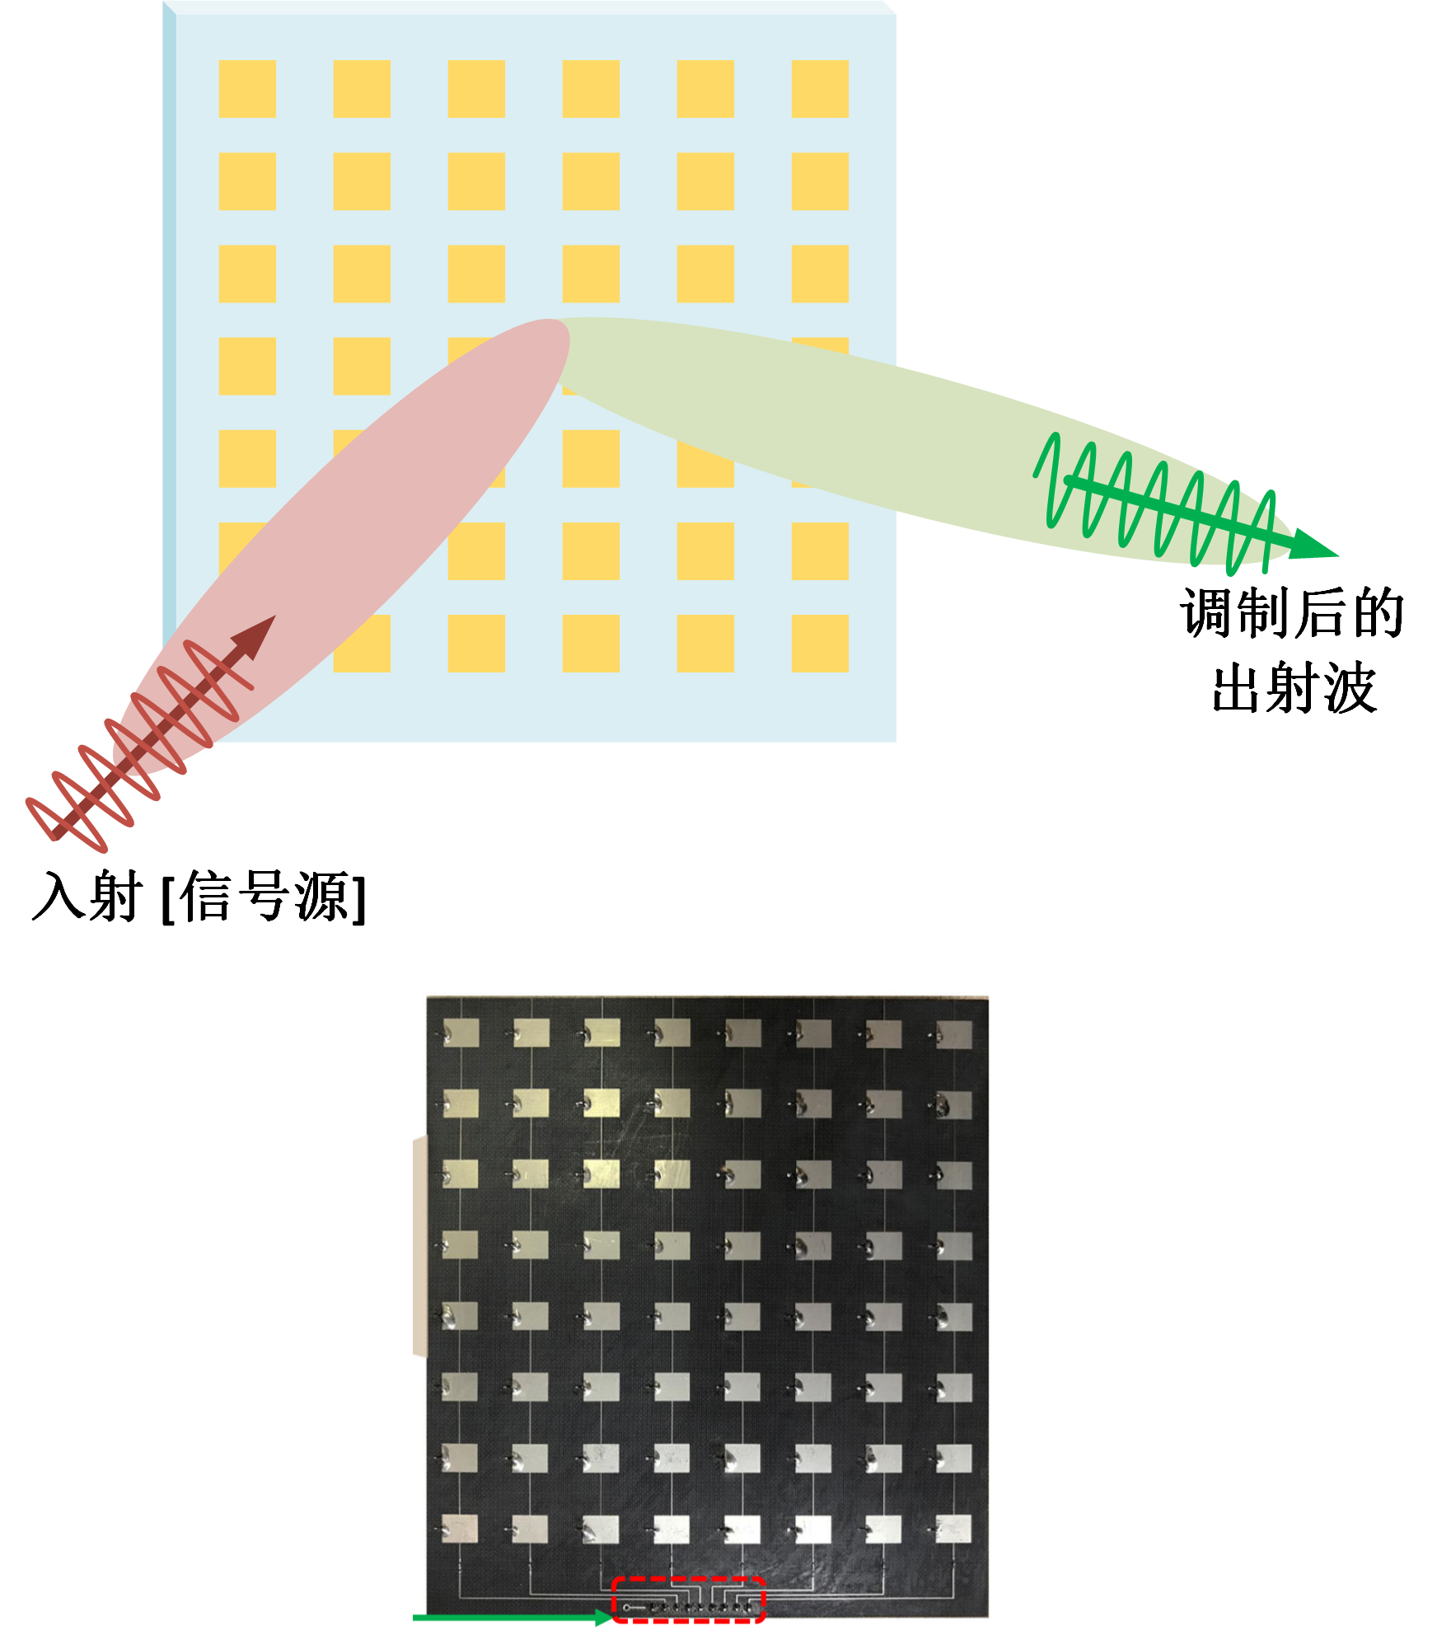
Classification
Transmission
Reflection
Similar principle and effect
Reflection: easier to design & less control circuit requirements

Slide 8
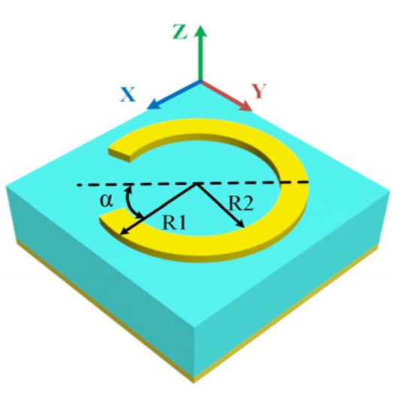
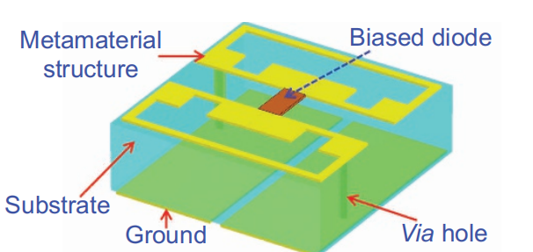
Classification
Passive
Active
Passive: Stable, Easy to design, Fixed Scattering Pattern
Active: Flexible, Hard to design, Arbitrary Control of EM wave
[1] Bao, Lei, et al. [2] Cui TJ, et al.

Slide 9
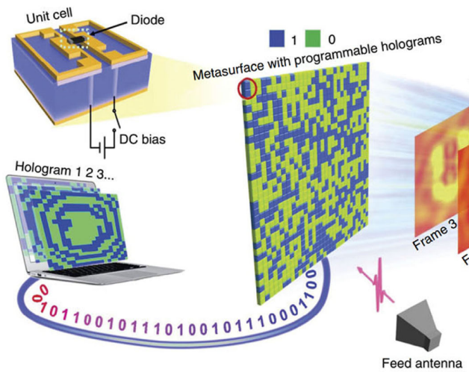
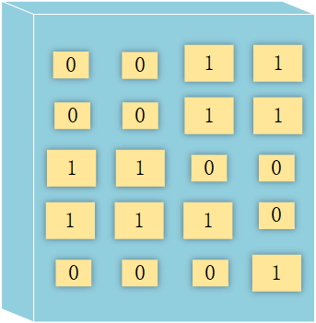
Programmable
Programmable
Coding
Phase, Amplitude, Polarization Modulation
Hard to achieve continuously tunable phase
Trade off: Phase granularity, radiation efficiency → Multilayer
[3] A. H. Abdelrahman, A. Z. Elsherbeni and F. Yang. [12] Li L, et al.

Slide 10
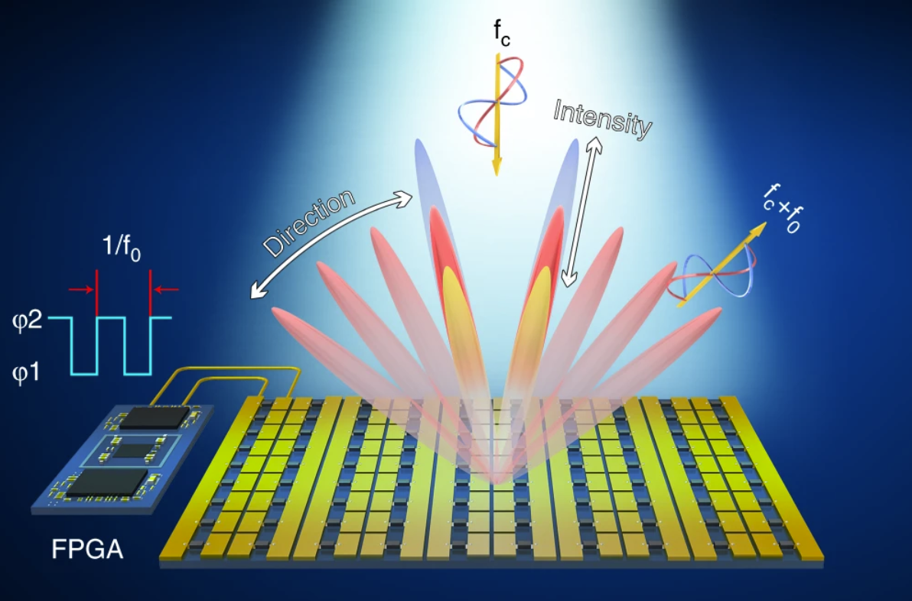
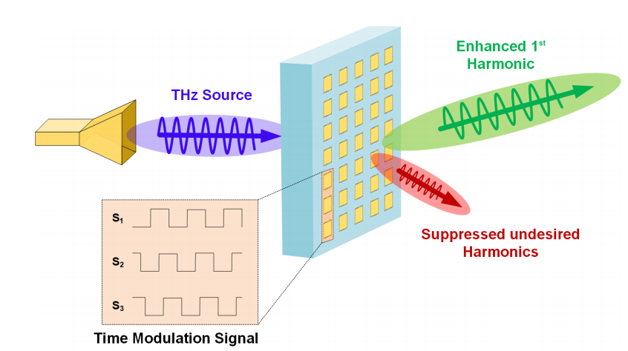
4-th Dimension
Continuous coding
Phase & Amplitude control
Flexible Space Modulation
Harmonic Suppression
Reduce loss
[4] Dai JY, et al.

Slide 11
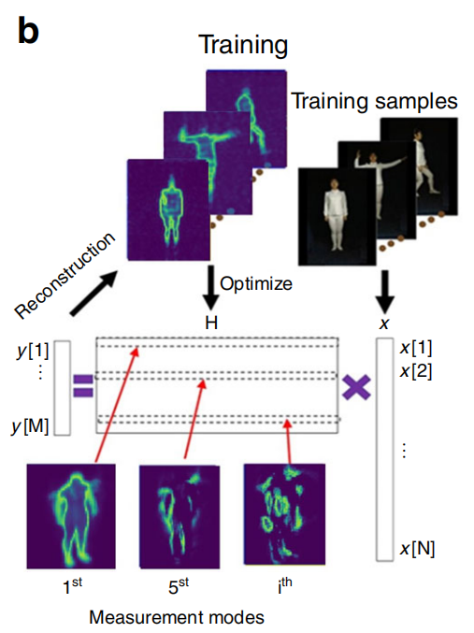
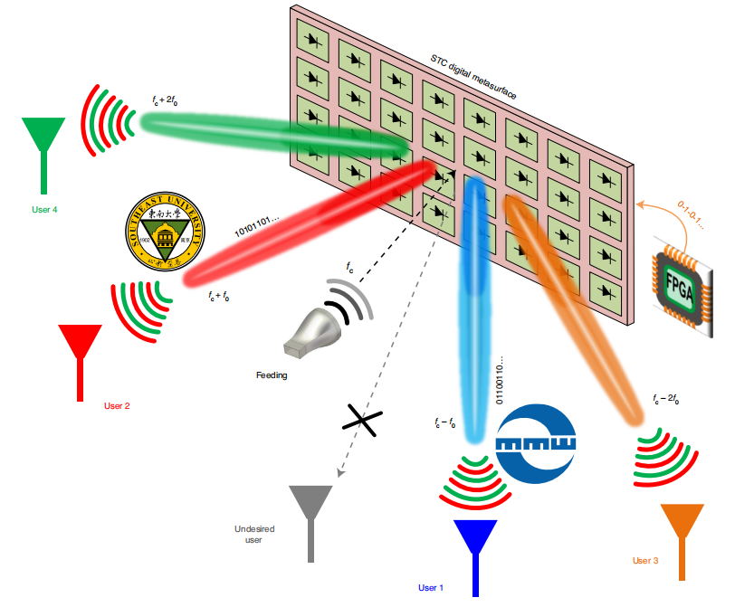
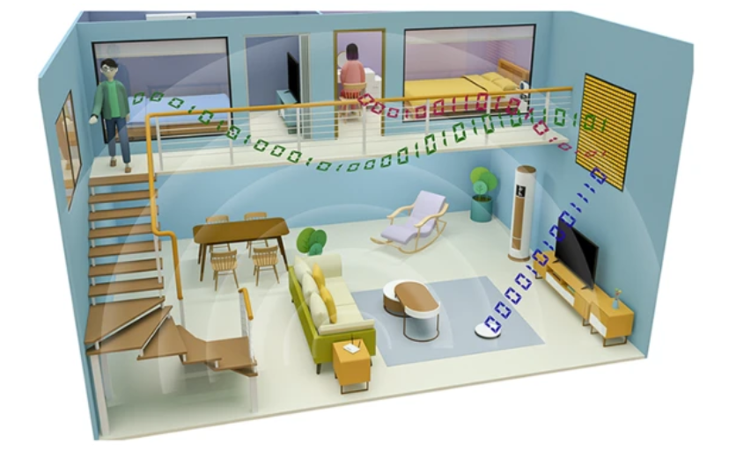
More Applications
Metasurface Imaging
Encrypted MIMO Communication
Multi-user
Machine Learning based Imaging System
Utilization of Harmonics
Special Coding Pattern
[5] Li L, et al. [6] Zhang, Lei, et al. [7] Zhao Hanting, et al.

Slide 12
Outline
Introduction
5G Communication
Metasurface
Harmonic Suppression Theory
Unit Cell Design
Simulation Results
Conclusion

Slide 13
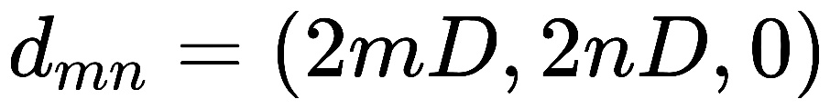
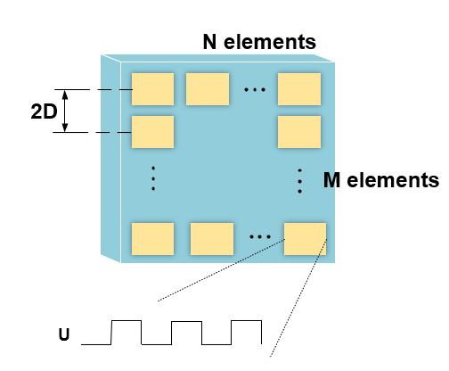
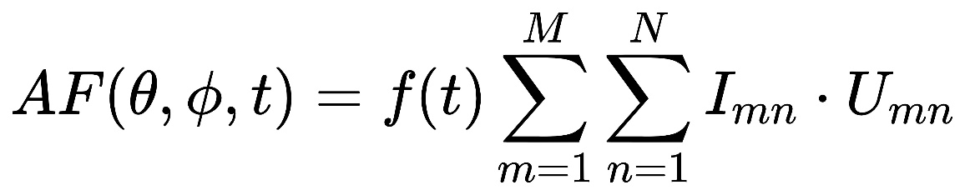
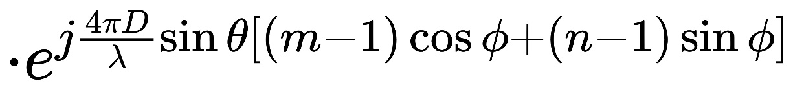
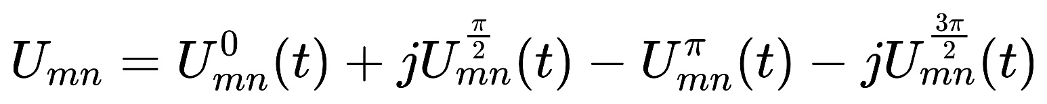
Harmonic Suppression Theory
Phased Array

Slide 14
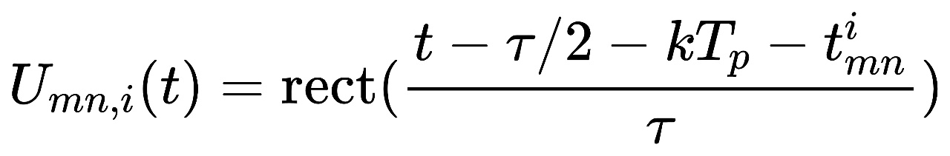
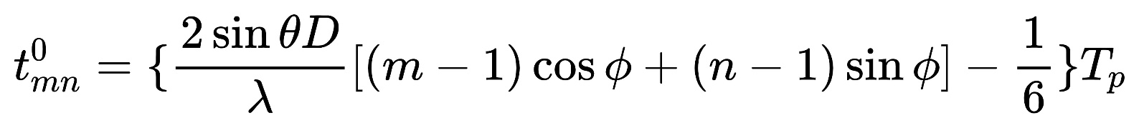
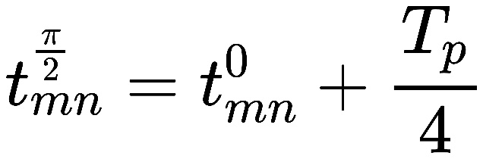
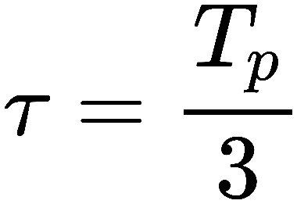
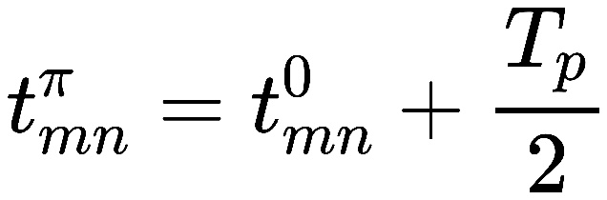
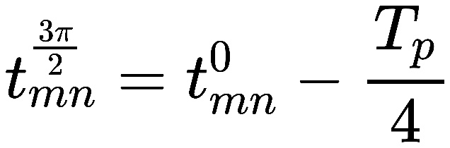
Harmonic Suppression Theory
Phased Array

Slide 15
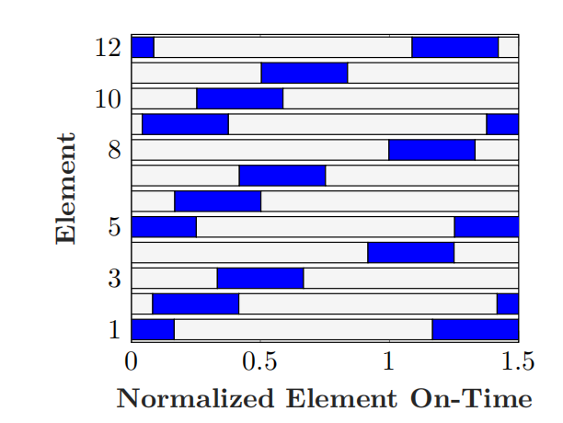
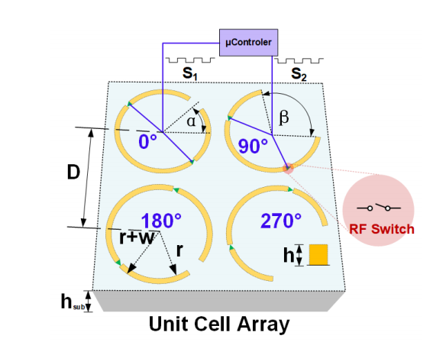
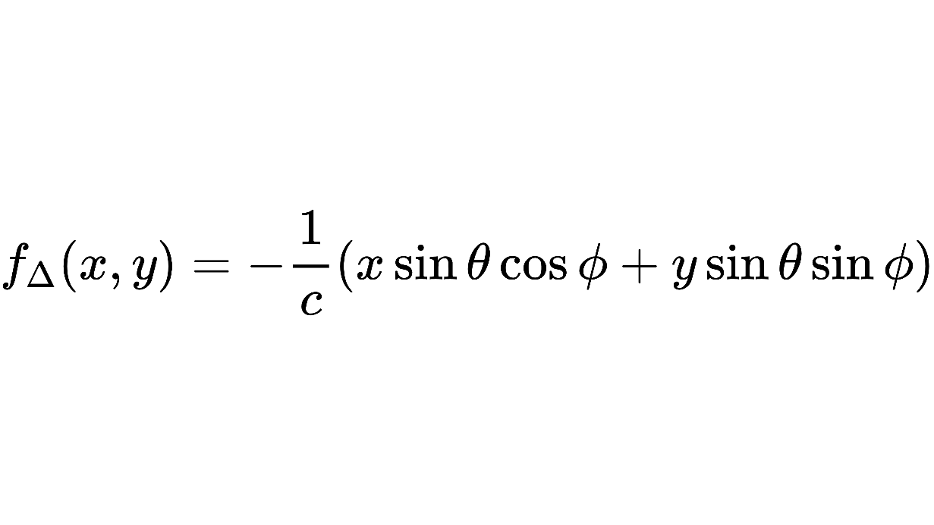
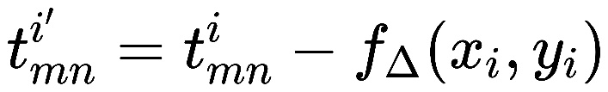
Harmonic Suppression Theory
STPM

Slide 16
Outline
Introduction
5G Communication
Metasurface
Harmonic Suppression Theory
Unit Cell Design
Simulation Results
Conclusion

Slide 17
Unit Cell Design
Four 1-bit elements with 5 states
Off state: Low transmittance
On states: Phase modulations
8 pin diodes controlled by FPGA

Slide 18
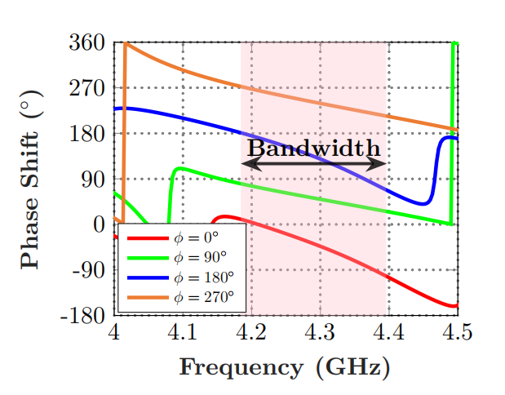
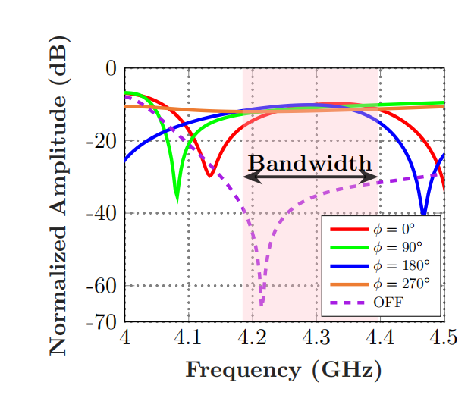
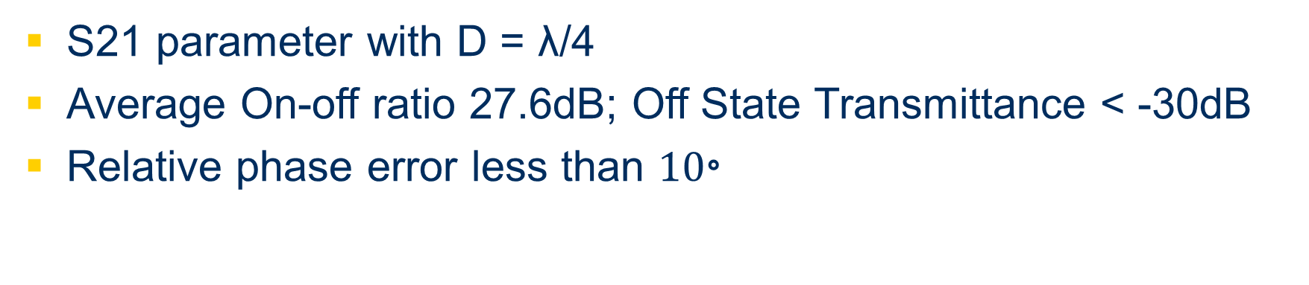
Unit Cell Design
Phase
Amplitude
S21 parameter with D = λ/4
Average On-off ratio 27.6dB; Off State Transmittance < -30dB
Relative phase error less than ${10}^{。}$

Slide 19
Outline
Introduction
5G Communication
Metasurface
Harmonic Suppression Theory
Unit Cell Design
Simulation Results
Conclusion

Slide 20
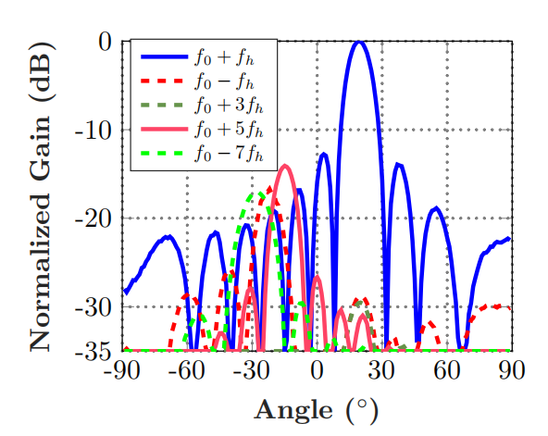
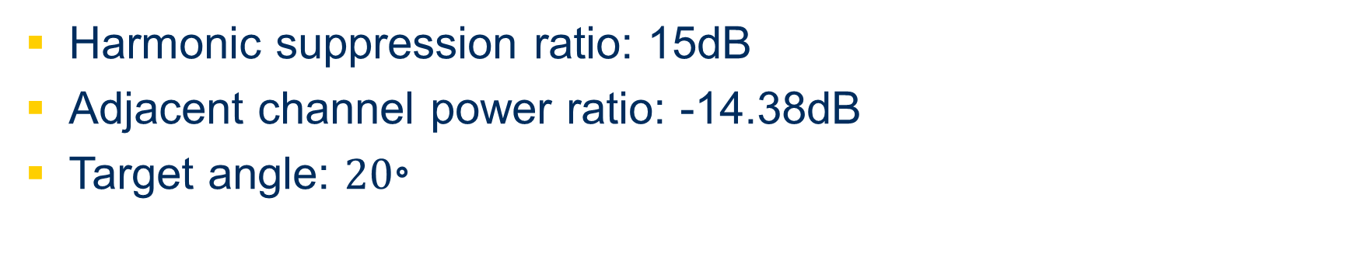
Simulation Result
Harmonic suppression ratio: 15dB
Adjacent channel power ratio: -14.38dB
Target angle: ${20}^{。}$

Slide 21
Outline
Introduction
5G Communication
Metasurface
Harmonic Suppression Theory
Unit Cell Design
Simulation Results
Conclusion

Slide 22
Conclusion
A time modulated programmable metasurface architecture and its modulation sequences are designed to ensure both flexibility and efficiency of beamforming and undesired harmonics suppression.
The metasurface unit cell contains four ”ON” states and one ”OFF” state with low transmittance. Within the bandwidth, the system shows a high ON-OFF ratio and high harmonic suppression ratio.
All these results prove the ability of the STPM to achieve high efficient beamforming and undesired harmonic suppression, indicating the potential for applying in practical communication applications.

Slide 23
References
[1] Bao, Lei, et al. "Multi-beam forming and controls by metasurface with phase and amplitude modulations." IEEE Transactions on Antennas and Propagation 67.10 (2019): 6680-6685.
[2] Cui TJ, et al. Coding metamaterials, digital metamaterials and programmable metamaterials. Light Sci Appl. 2014;3:e218.
[3] A. H. Abdelrahman, A. Z. Elsherbeni and F. Yang, "Transmission Phase Limit of Multilayer Frequency-Selective Surfaces for Transmitarray Designs," in IEEE Transactions on Antennas and Propagation, vol. 62, no. 2, pp. 690-697, Feb. 2014, doi: 10.1109/TAP.2013.2289313.
[4] Dai JY, et al. Independent control of harmonic amplitudes and phases via a time-domain digital coding metasurface. Light Sci Appl. 2018;7:90.
[5] Li L, et al. Machine-learning reprogrammable metasurface imager. Nat Commun. 2019;10:1082.
[6] Zhang, Lei, et al. "A wireless communication scheme based on space-and frequency-division multiplexing using digital metasurfaces." Nature Electronics 4.3 (2021): 218-227.
[7] Zhao, Hanting, et al. "Metasurface-assisted massive backscatter wireless communication with commodity Wi-Fi signals." Nature communications 11.1 (2020): 1-10.
[8] T. L. Marzetta, "Massive MIMO: An Introduction," in Bell Labs Technical Journal, vol. 20, pp. 11-22, 2015, doi: 10.15325/BLTJ.2015.2407793.
[9] Q. Wu and R. Zhang, "Towards Smart and Reconfigurable Environment: Intelligent Reflecting Surface Aided Wireless Network," in IEEE Communications Magazine, vol. 58, no. 1, pp. 106-112, January 2020,
[10] C. Liaskos, S. Nie, A. Tsioliaridou, A. Pitsillides, S. Ioannidis and I. Akyildiz, "A New Wireless Communication Paradigm through Software-Controlled Metasurfaces," in IEEE Communications Magazine, vol. 56, no. 9, pp.
[11] Popov, Vladislav, et al. "Reconfigurable Sparse Metasurface: Beamforming Beyond Phase Gradient Heuristics." 14th European Conference on Antennas and Propagation (EUCAP 2020). 2020.
[12] Li L, et al. Electromagnetic reprogrammable coding-metasurface holograms. Nat Commun. 2017;8:197.

Slide 24

Thank You!

